Slide 1


Uncovering the ‘Hidden’ Curriculum
DFCM Faculty Development Committee
2019-2020
Photo by Annie Spratt on Unsplash

Slide 2
Session Goal
The overarching goal of this session is to raise your awareness of and understanding about Hidden Curriculum (HC) in health professional education and to provide you with strategies to recognize and manage the impact of both positive and negative aspects of HC when it occurs.

Slide 3
Important to remember
While the main purpose of this module is to help faculty become aware of the hidden curriculum and how it pertains to resident education, we must also acknowledge that the hidden curriculum directly affects faculty as well, in both positive and negative ways

Slide 4
Learning Objectives
At the end of this session, the participants will:
Describe of the hidden curriculum and articulate its impact in medical education
Identify examples of the hidden curriculum in the learning environment
Incorporate teaching about the hidden curriculum into practice
Hariharan J. Science 17 May 2019

Slide 5

Discuss at your tables – Case #1
A medical clerk is shadowing a family physician who is attending to a patient presenting with chronic musculoskeletal pain. The patient expresses interest in seeing a naturopath for pain control. The physician puts her hand on her forehead and sighs, then replies: “Well, that is up to you but there is really no evidence for any of that type of treatment.”
Notes:
***SITE PRESENTERS: FEEL FREE TO USE YOUR OWN CASES INSTEAD IF YOU PREFER.***
For slides 5 and 6 we will have the audience break into small groups. Assign half of the group to 1 scenario and the other to the 2nd scenario. Using the two scenarios on slides 5 and 6, give them 5 minutes to discuss the scenarios. Is there evidence of HC? If so, where do they think it may be coming from and why?
This will be followed by a group debrief. Ask each group to identify a reporter for the group debrief.
For large groups, the facilitator will ask the reporters from the first scenario to share a brief summary of their conversation, start with two tables and then ask if any other group doing the same scenario has additional information not already shared.
(From slide 10 - Sources of the HC for Case #1: physical gestures, how things are said, role modeling)
Each group needs a paper handout of the case they are to discuss. These handouts are attached as Word documents with this module and include the questions the groups are meant to consider when discussing these cases:
What stands out in these cases?
What does the learner take away in these cases?
How is the message delivered in each case?

Slide 6
Discuss at your tables – Case #2
It is 5:00pm and several MDs in a shared practice are still seeing patients and working in their offices. A young MD finishes his afternoon clinic and his chart review with the learner. He knows he could stay longer to complete notes, but states to the learner that he is leaving to get home to his family and will come in early tomorrow to finish.
Notes:
***SITE PRESENTERS: FEEL FREE TO USE YOUR OWN CASES INSTEAD IF YOU PREFER.***
For slides 5 and 6 we will have the audience break into small groups. Assign half of the group to 1 scenario and the other to the 2nd scenario. Using the two scenarios on slides 5 and 6, give them 5 minutes to discuss the scenarios. Is there evidence of HC? If so, where do they think it may be coming from and why?
This will be followed by a group debrief. Ask each group to identify a reporter for the group debrief.
For large groups, the facilitator will ask the reporters from the first scenario to share a brief summary of their conversation, start with two tables and then ask if any other group doing the same scenario has additional information not already shared.
From slide 10 - Sources of the HC for Case #2: role modeling positive behaviour with explanation of wellness aspect and setting a tone on culture at work/learning – how the organization actually behaves versus what they ‘preach’ box; behavior box; what is said at orientation about balance and well-being box.
Each group needs a paper handout of the case they are to discuss. These handouts are attached as Word documents with this module and include the questions the groups are meant to consider when discussing these cases:
What stands out in these cases?
What does the learner take away in these cases?
How is the message delivered in each case?

Slide 7
Questions to Discuss in Groups
What stands out in these cases?
What does the learner take away in these cases?
How is the message delivered in each case?

Slide 8


Group Debrief

Slide 9
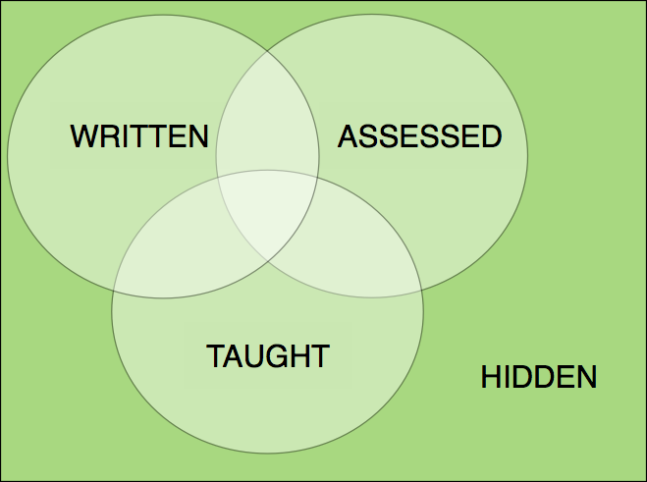
“a set of influences that function at the level of organizational structure and culture”
Frederic Hafferty
The Hidden Curriculum
“
Image from My Aspergers Child
Notes:
The Hidden Curriculum lies outside of the formal curriculum in that it is not formally taught or evaluated.
Can be positive or negative
( Highlight that it is frequently framed as negative, but this was not the original intention of the definition)
Another Hafferty Quote:“process, pressures, and constraints that fall out of the formal curriculum, often unarticulated or unexplored”

Slide 10
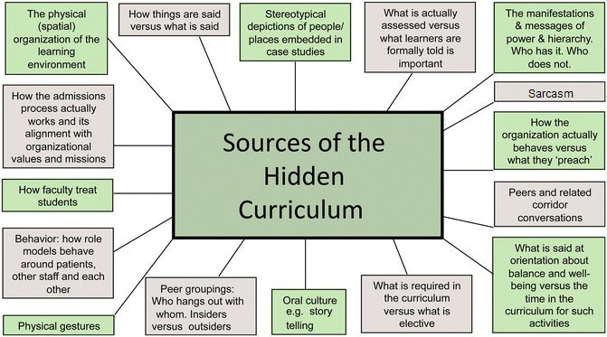
Sources of HC
Diagram adapted from Hafferty F.W., Finn G.M. (2015) The Hidden Curriculum and Anatomy Education. In: Chan L., Pawlina W. (eds) Teaching Anatomy. Springer, Cham

Slide 11

Difficult patient?
Notes:
This slide and the following two slides are illustrating examples of sources of hidden curriculum
Facilitator notes for Difficult Patient:
Groaning/sighing when seeing difficult patients on day list
Scheduling residents to see your (staff’s) difficult patients
Positive example: the difficult patient can be used to convey teaching pearls like empathy and how to manage transference and cross-transference
Feel free to add your own examples

Slide 12

Work overload
Notes:
Facilitator notes for Work Overload: e.g.
faculty and residents checking and sending messages/e-mails at 11pm or later or on weekends; going in or remote logging-on after hours or on weekends to complete/catch-up on work
rewarding residents on staying late or coming in after hours when not originally scheduled
Feel free to add your own examples

Slide 13

Role model
Notes:
Facilitator notes for Role Model:
Role-modelling includes how we interact with patients but also how we role model interprofessional relationships through such actions as how we talk to secretaries, how we engage with locating, how we speak with consultants and how do we respond when we are being consulted
Feel free to add your own examples

Slide 14
Voice of the Learner Survey

Slide 15
Negative Impact of the HC
Lack of accountability to patients
Health practitioner overload
Teachers’ negative attitudes and apathy
Electronic health record impact on patient depersonalization
Rajput V, Mookerjee AL, Cagande C. The contemporary hidden curriculum in medical education. AMEE MedEdPublish 2017
Notes:
Lack of accountability to patients: contributed to, for example, by increasing lack of long-term relationships between physician and patient and frequent turn-over of MRP, especially while in hospital
Health practitioner overload: for example, as a result of too much busy-work; excessive documentation to justify a billing code or protection against perceived medicolegal risk; requirement to complete multiple forms/documents
Teachers’ negative attitudes/apathy: for example, judgmental remarks about a patient with chronic pain or substance use issues; teaching trainees that they shouldn’t “get too close” to their patients, with the stated or implied message that “enforced detachment” is necessary to maintain objectivity in decision making
Electronic health record: typing while trying to listen to a patient’s story makes delivery of compassionate care challenging; example of Dr. Varghese in a NEJM article: there are now 2 patients, the “i-patient” and the real-life patient and health practitioners are trying to “fix” the “i-patient” rather than listening to the real-life patient

Slide 16
Negative Impact of the HC
Negative effect of “work-life balance”
“Difficult patient” concept
Negative impact of evidence-based medicine on a patient-centred approach
Influence of “Legal Phobia”
Rajput V, Mookerjee AL, Cagande C. The contemporary hidden curriculum in medical education. AMEE MedEdPublish 2017
Notes:
Work-life balance: the authors state that this is generally a laudable concept, but suggest that it is becoming a preoccupation; the authors also suggest that it is one of the main reasons that medicine is becoming a “job” rather than a “career”
Difficult patient concept: this refers, for example, to a patient who is angry, or emotionally needy, or just asks too many and too difficult questions; when teachers use this labeling, it serves to encourage avoidance of such patients when these are the patients that generally need more time, attention and compassion
Negative aspects of “evidence-based medicine”: the overzealous emphasis of this otherwise positive concept can result in the delivery of culturally and personally suboptimal care for that individual patient; clinical decisions in a patient-problem centreed approach require evidence, knowledge, intuition, clinical experience and an understanding of organizational influences; the cognitive critical decision and reasoning processes of senior faculty must be analyzed and demonstrated for students and residents at the bedside and/or in all educational activities; learners should understand that these processes should occur both with and without the support of evidence from the literature
Influence of legal phobia: for example, the practice of “defensive medicine” can be expensive to the system and also negatively affect compassionate care

Slide 17
Positive Impact of the HC
Development of kindness and caring attitudes through positive role-modeling
Respect for work-life balance through positive role-modeling
Elimination of hierarchy through mentoring of professional and equal collaboration with IPEs
Development of an Environment of Transparency
  Personal accountability
  Apologizing for mistakes

Slide 18
How do we manage the HC?
Reflective Competency Curriculum
Priming
Noticing
Processing
Choosing
Holmes CL, Harris IB, Schwartz AJ, Regehr G. Harnessing the hidden curriculum: a four-step approach to developing and reinforcing reflective competencies in medical clinical clerkship. Adv in Health Sci Educ (2015) 20:1355-137
Notes:
Use this to highlight potential curricular activity of addressing the HC, with emphasis on reflection which allows positive and negative experiences to be recognized and to reinforce values/behaviours that allow for the development of trainees who are compassionate
Priming: presenting and discussing examples of pressures to conform
Priming has been described as “Reflection-before-action” (Sandar): In being explicit about the pressures to conform, by stimulating reflection before experience, we are “priming” students to notice situations in which they may feel pressure to act in a way that may not feel as appropriate
Priming would occur prior to introducing of students to the contexts in which these challenges are likely to occur and involves presentation and discussion of examples of
pressures to conform. Learning could begin with students reflecting on past experiences, in order to sensitize them to the possibility that they are subject to such pressures. They could then be asked to anticipate where these challenges might occur for them in the clinical world.

Slide 19
How do we manage the HC?
Reflective Competency Curriculum
Priming
Noticing
Processing
Choosing
Holmes CL, Harris IB, Schwartz AJ, Regehr G. Harnessing the hidden curriculum: a four-step approach to developing and reinforcing reflective competencies in medical clinical clerkship. Adv in Health Sci Educ (2015) 20:1355-137
Notes:
Use this to highlight potential curricular activity of addressing the HC, with emphasis on reflection which allows positive and negative experiences to be recognized and to reinforce values/behaviours that allow for the development of trainees who are compassionate
Noticing: observing and documenting witnessed experiences in new clinical roles
Noticing would involve students observing and documenting their experiences in their new clinical roles, after priming them to observe pressures to conform or comply with
unwanted behaviors. One noticing technique that might be used is self-monitoring (keeping electronic notes or a written diary), whereby the student acts as a participant observer (Kawulich 2005) or self-ethnographer (Feudtner and Christakis 1994) of his or her own acculturation process. An important feature of this step is taking notes
immediately to avoid contamination of the memory, as we have a remarkable ability to reconstruct memory to maintain our self-concept (Loftus 2003; Eva and Regehr 2008).

Slide 20
How do we manage the HC?
Reflective Competency Curriculum
Priming
Noticing
Processing
Choosing
Holmes CL, Harris IB, Schwartz AJ, Regehr G. Harnessing the hidden curriculum: a four-step approach to developing and reinforcing reflective competencies in medical clinical clerkship. Adv in Health Sci Educ (2015) 20:1355-137
Notes:
Use this to highlight potential curricular activity of addressing the HC, with emphasis on reflection which allows positive and negative experiences to be recognized and to reinforce values/behaviours that allow for the development of trainees who are compassionate
Processing (aka ‘guided reflection’): making sense of their experiences
Reflecting (Processing) is a crucial step in learning, whereby learners make sense of their experiences. This could involve students writing blogs, narratives, reflective essays or creating digital stories documenting these experiences, and then bringing them back together to report on and collectively reflect on their experiences, with guidance from a faculty member (Sandars et al. 2008). Informed by the reflection literature, we recommend a collaborative inquiry model, whereby learners drive the process of reflection, supported by a guide with specific expertise in transformative learning through critical inquiry (Brookfield 1987; Frankford et al 2000; Mezirow 1990; Sandars and Murray 2011

Slide 21
How do we manage the HC?
Reflective Competency Curriculum
Priming
Noticing
Processing
Choosing
Holmes CL, Harris IB, Schwartz AJ, Regehr G. Harnessing the hidden curriculum: a four-step approach to developing and reinforcing reflective competencies in medical clinical clerkship. Adv in Health Sci Educ (2015) 20:1355-137
Notes:
Use this to highlight potential curricular activity of addressing the HC, with emphasis on reflection which allows positive and negative experiences to be recognized and to reinforce values/behaviours that allow for the development of trainees who are compassionate
Choosing: takes place during the moment of adopting or not adopting certain behaviours in practice
Choosing is the final step in the reflective process proposed. The first three steps, priming, noticing and reflecting on socialization pressures and their experiences with these
pressures are geared ultimately to empower students to be in control of their choices in behaviors and actions in their personal, professional and patient care roles. Choosing
occurs in the moment of adopting or not adopting certain behaviors in practice. Making good choices in the moment is the ultimate outcome of the curriculum, but consistent with the literature on the cycle of reflection, should not be the endpoint of the curriculum. Thus, these choices should be documented. Students could then share with their group (guided reflection-on-action) how they managed the difficulties associated with choosing not to
adopt observed behaviors.
Again, these activities should occur in a non-judgmental and safe environment, where rapport and trust have been built, maintaining a culture of respect
(Leape et al. 2012b). With time and confidence, this could occur in the context of their clinical teams. Initially however, these reflective activities would be developed in their
academic learning community, where students share and process their experiences with their peers and a faculty mentor not involved in clinical assessment of the student.

Slide 22
Using the Reflective Competency Curriculum with Case #1
A medical clerk is shadowing a family physician who is attending to a patient presenting with chronic musculoskeletal pain. The patient expresses interest in seeing a naturopath for pain control. The physician puts her hand on her forehead and sighs, then replies: “Well, that is up to you but there is really no evidence for any of that type of treatment.”
Notes:
The following slides present an example of how we could use the 4-step reflective competency curriculum with learners.

Slide 23
Priming
Prepare learners to be mindful and respectful of other professionals’ or patients’ opinions about medical approaches to treatment
  e.g. respecting patient’s wish to follow a naturopathic approach to medical care

Slide 24
Noticing
Learners witnessing this interaction would document or keep a log of this experience immediately (to ensure maximum accuracy of details of the event) in order to allow them to reflect and discuss later in facilitated sessions

Slide 25
Processing (or Guided Reflection)
Learner has a portfolio session asking them to discuss an experience they witnessed or were a part of and reflect on what they took away from the experience and what it meant to them

Slide 26
Choosing
  Provided that a safe, trusting environment had been established, the student chooses to ask to speak with the preceptor after the interaction with the patient and express their feelings of what they observed
  Learner chooses to manage the situation differently the next time, e.g. the learner chooses to offer to research the benefits of naturopathic interventions for pain management

Slide 27
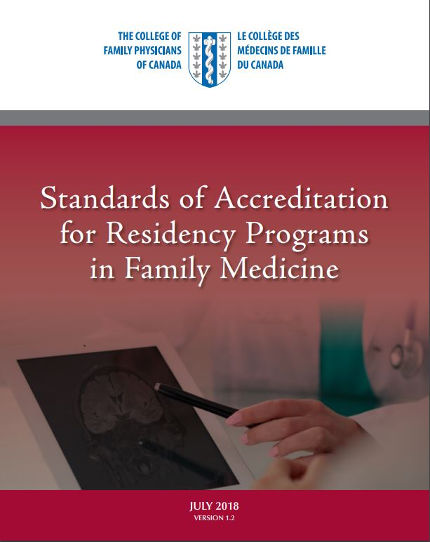
How do we manage the HC?
Micro:
1:1 with preceptor during conversations (3.3.1.4)
HC-focused field note – under professionalism competency
Learner reflection
Meso:
  At resident’s review with the Program Director,
  there is an embedded question specifically about
  hidden curriculum
  Inclusion in orientation and AHD for residents
  (eg Hidden Values slide in the ETHICS curriculum)
Macro:
  Faculty development for all teachers on this topic – BASICS module
  Review of U of T cohort data from CFPC survey (9.1.1.3)
Notes:
How are we addressing it at the DFCM
Micro: preceptors include concepts about HC with their learners and inquire if they are experiencing it in their learning environment
(3.3.1.4: Teachers reflect on the potential impacts of the hidden curriculum on the learning experience).
Meso: Preceptors and residency program directors ensure that there is a specific question asked about HC during learner reviews.
Macro:
This is specifically the FMLS data
(9.1.1.3: The program evaluates the potential impact of the hidden curriculum on the residency program.)

Slide 28

Identifying hidden values
Notes:
Slide 28 and Slide 29 are to be used if there is a question asked about the Hidden Values Slide (mentioned on slide 27) – The two hidden slides are taken from the Ethics curriculum so that you can be able to refer to them if the question does arise.

Slide 29
Mrs. W. is an 87 year old woman who lives alone in the community. You are doing a home visit today after her recent discharge from hospital. This has been her fourth admission in the last two months. Three admissions were related to worsening heart failure from medication non-compliance. She had stopped taking her water pills because she was having trouble making it to the bathroom independently. Some nights she sleeps in her recliner because she is too short of breath to climb up the stairs. On her most recent admission, the Cardiologist suggested a pacemaker but she refused. Her daughters are frustrated that the hospital hasn’t “fixed” their mother and that she continues to get admitted for the same thing (heart failure) and this time almost ended up in the intensive care unit.
Her other medical conditions include osteoarthritis, COPD, coronary artery disease, cataracts and some new cognitive impairment. Although her vision is very poor she is not considered a candidate for surgery because of her advanced age.
She lives alone in a two-story house since her husband died three years ago. Her three daughters live just outside the city but were unwilling to have her come and live with them. One of her daughters has suggested that it’s time to move to a nursing home where she will be safer. They mention that her fridge is full of rotting food and there are over 50 boxes of cereal stashed around the house. They are angry that Mrs. W was found capable of living at risk each time she was assessed and have filed several complaints with the hospital for discharging her home. Mrs. W is adamant that she will never move out of her house. The hospital and community teams are frustrated with this difficult family.

Slide 30
Other examples of managing the HC
Reflective learning -- specific focus on hidden curriculum*
Interprofessional seminars - debating impact of Hidden Curriculum*
Balint groups
Peer-support groups
*Rajput V, Mookerjee AL, Cagande C. The contemporary hidden curriculum in medical education. AMEE MedEdPublish 2017

Slide 31
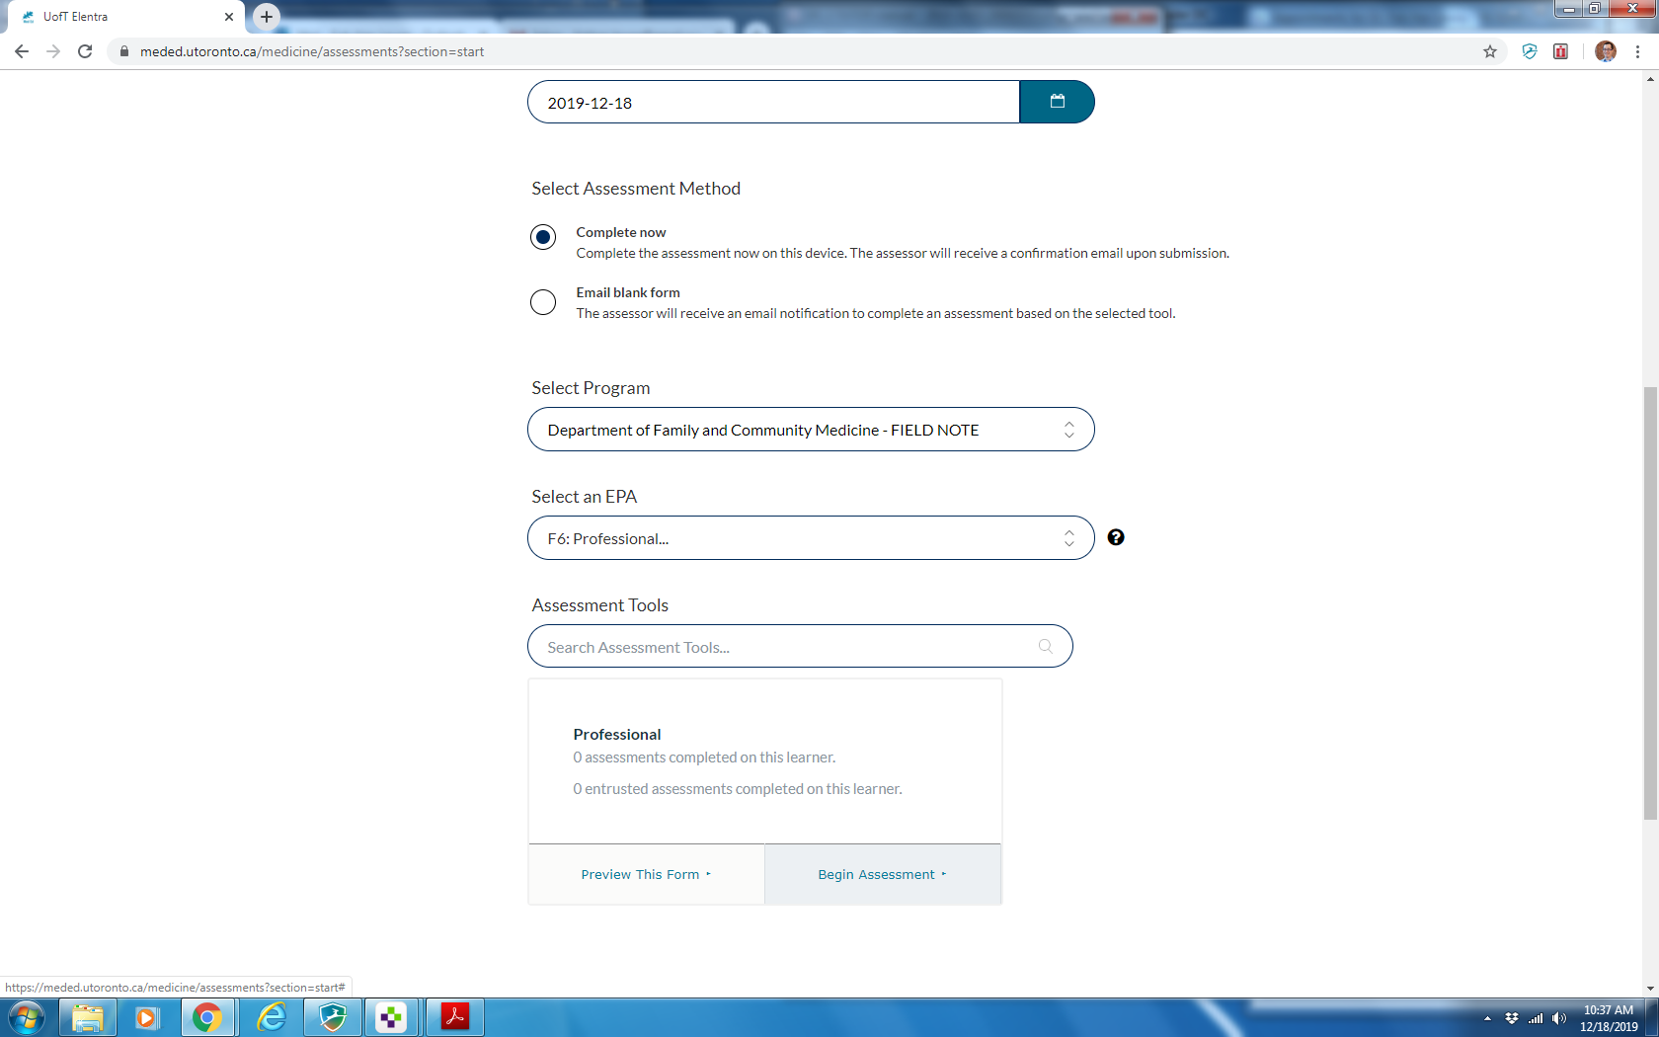
HC Field Note - Professional
Notes:
This slide is included so that participants (faculty) are aware that using the CanMEDS-FM role of “Professional” would likely be the best one to choose when documenting a Field Note relating to the Hidden Curriculum (for example, when documenting a situation where the learner makes an effort to process learning experiences relating to the hidden curriculum using the Reflective Competency Curriculum 4-step process: slides 18-21).

Slide 32
Session Mini Quiz
1 | Hidden curriculum always negatively impacts the learning experience | T or F
2 | Processing is also known as: a) Observing and documenting witnessed experiences b) Adopting or not adopting certain behaviours c) Guided reflection d) Discussing examples of pressure to conform | A B C D
3 | HC can impact education and practice in the following ways: a) Practitioner over working b) ‘Labeling’ of patients c) Causing negative attitudes and apathy d) All of the above | A B C D
Notes:
The quiz is projected and learners are asked to provide their responses to the questions.

Slide 33
Session Mini Quiz
1 | Hidden curriculum always negatively impacts the learning experience | F
2 | Processing is also known as: a) Observing and documenting witnessed experiences b) Adopting or not adopting certain behaviours c) Guided reflection d) Discussing examples of pressure to conform | C
3 | HC can impact education and practice in the following ways: a) Practitioner over working b) ‘Labeling’ of patients c) Causing negative attitudes and apathy d) All of the above | D
Notes:
False is the correct answer. The Hidden Curriculum is not always negative. There are occasions when the HC is positive and has the potential to have positive outcomes for learners by supporting good choices in the future for themselves and their team, for their patients and for their own future students.
C is the correct answer. The other options are examples of priming, noticing and choosing steps in addressing the HC
D is the correct answer. Negative HC can impact learners and their future practices in many ways as discussed earlier in this session.

Slide 34

Snowball Activity
Edutopia: "22 Powerful Closure Activities"
https://www.edutopia.org/blog/22-powerful-closure-activities-todd-finley
Notes:
***Presenters can choose to do this Snowball Activity as described below OR instead they could simply ask participants to take a moment to think about their main (only 1) take-home point from the module and how they will apply what they have learned in their practice/teaching activities. Then, presenters can choose to ask all or some (depending on time) of the participants to share their thoughts.***
Making a commitment to change:
Provide the audience with ½ sheets of blank paper at the start of the session.
At the end of the session, ask them to take 1 minute to write down on the paper – what the main point they took away from the session was, and how they will apply what they have learned in their practice/teaching activities.
Ask them to crumple the papers into a ball. The group stands (if large group, then break into smaller groups), throws the paper into a circle (on the floor or on the tables) and then they each pick up someone else’s ball and reads it to the group.
The activity should only take 5 minutes, but it’s a good way to end a session and that way people aren’t shy about saying what they learned or what they will do, because they will be reading someone else’s statement.
NB: The facilitator must make it clear to the participants that only what is written on the page should be read out and shared. Some participants may feel like they want to expand and add to what was written, but this will make the length of the activity too long. If the group is large, consider having only 2-3 people share what was written on the snowball they picked up and the other comments could be compiled by the facilitators and send out electronically afterwards.

Slide 35
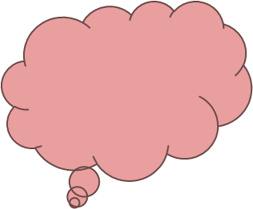
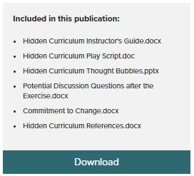
Education Resource
Kathleen Crapanzano, MD
Ann Schwartz, MD
Jacob Sperber, MD
Susan Stagno, MD
Lee Tynes, MD, PhD
The Impact of the
Hidden Curriculum on Resident Professional Formation
https://doi.org/10.15766/mep_2374-8265.10223
Crapanzano K, Schwartz A, Sperber J, Stagno S, Tynes L. Using a group exercise to teach about the hidden curriculum. MedEdPORTAL. https://doi.org/10.15766/mep_2374-8265.102232015;11:10223.
Notes:
This is an excellent module to use if you have at least an hour available for the Hidden Curriculum module.
It is added here as an option to use if desired or simply to provide as a resource for future self-learning for participants.

Slide 36
Hidden Curriculum – 1 page summary

Slide 37
Questions?
Module prepared for the University of Toronto, Department of Family & Community Medicine Faculty Development Committee by:
Thea Weisdorf
Deborah Kopansky-Giles
Milena Forte
Natascha Crispino
Carrie Schram
Rahul Jain

Slide 38
References
Holmes CL, Harris IB, Schwartz AJ, Regehr G. Harnessing the hidden curriculum: a four-step approach to developing and reinforcing reflective competencies in medical clinical clerkship. Adv in Health Sci Educ (2015) 20:1355-137
Rajput V, Mookerjee AL, Cagande C. The contemporary hidden curriculum in medical education. AMEE MedEdPublish 2017. https://doi.org/10.15694/mep.2017.000155
Silveira G L, et al. “Speed up”! The Influences of the Hidden Curriculum on the professional identity development of medical students. Health Professions Education (2018), https://doi.org/10.1016/j.hpe.2018.07.003
Lawrence C et al. The hidden curricula of medication education: A scoping Review. Academic Medicine. 2017. doi: 10.1097/ACM.0000000000002004
Hafferty F.W., Finn G.M. (2015) The Hidden Curriculum and Anatomy Education. In: Chan L., Pawlina W. (eds) Teaching Anatomy. Springer, Cham
Crapanzano K, Schwartz A, Sperber J, Stagno S, Tynes L. Using a group exercise to teach about the hidden curriculum. MedEdPORTAL. 2015;11:10223. https://doi.org/10.15766/mep_2374-8265.10223

